Slide 1
Neural Radiance Field with Refraction
Zhangkaiwen Chu

Slide 2
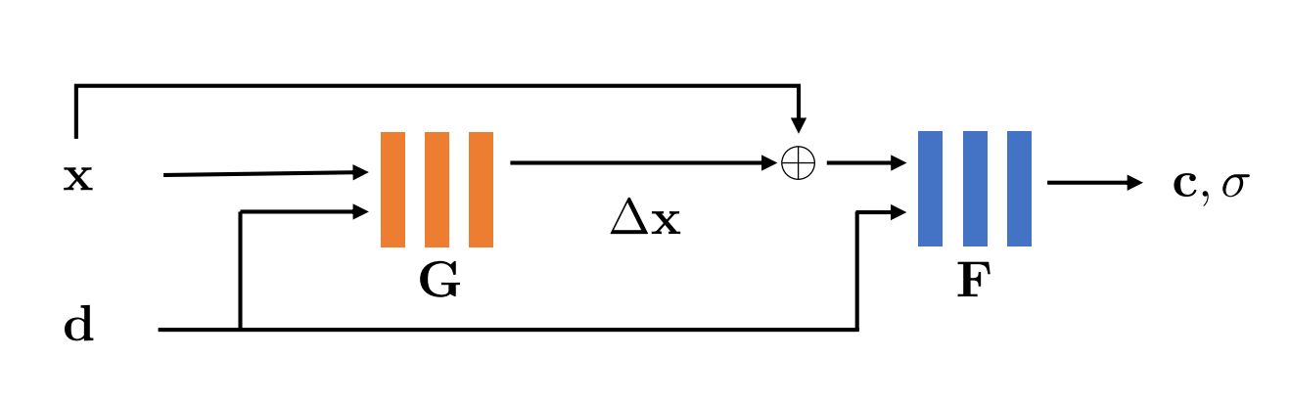
IB-NeRF
Neural Radiance Field assumes light travels in a straight line, so it is bad at learning specular and refractive effect.
IB-NeRF use a neural network to learn an offset field to model the light bending.

Slide 3


Results
NeRF with positional encoding
NeRF without positional encoding

Slide 4

Results
IB-NeRF without positional encoding
NeRF without positional encoding

Slide 5
Future Milestones
11/16 – 11/28: improve python implementation
Positional Encoding
Hyperparameter tuning
11/28 – 12/11: work on CUDA
Tiny CUDA Neural Networks
Instant Neural Graphics Primitives

